Slide 1



California Power Generation & Power sources
Who Run THE WORLD energy PROJECT

Slide 2
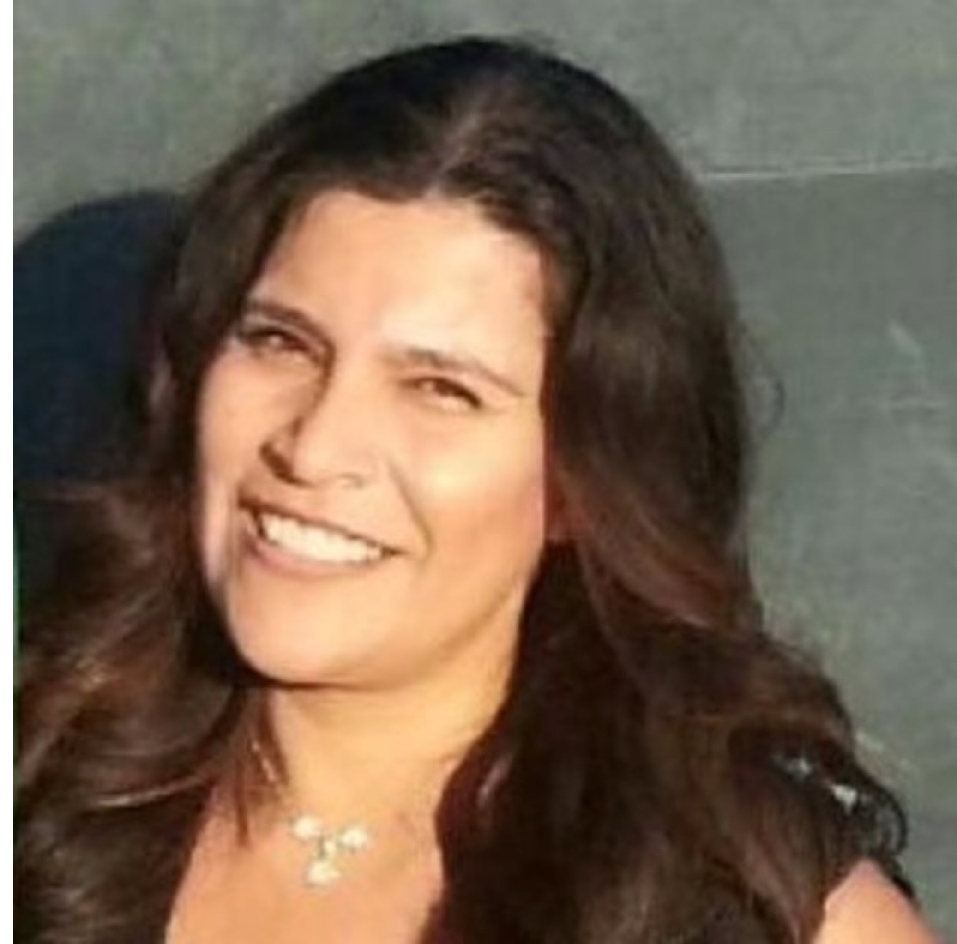


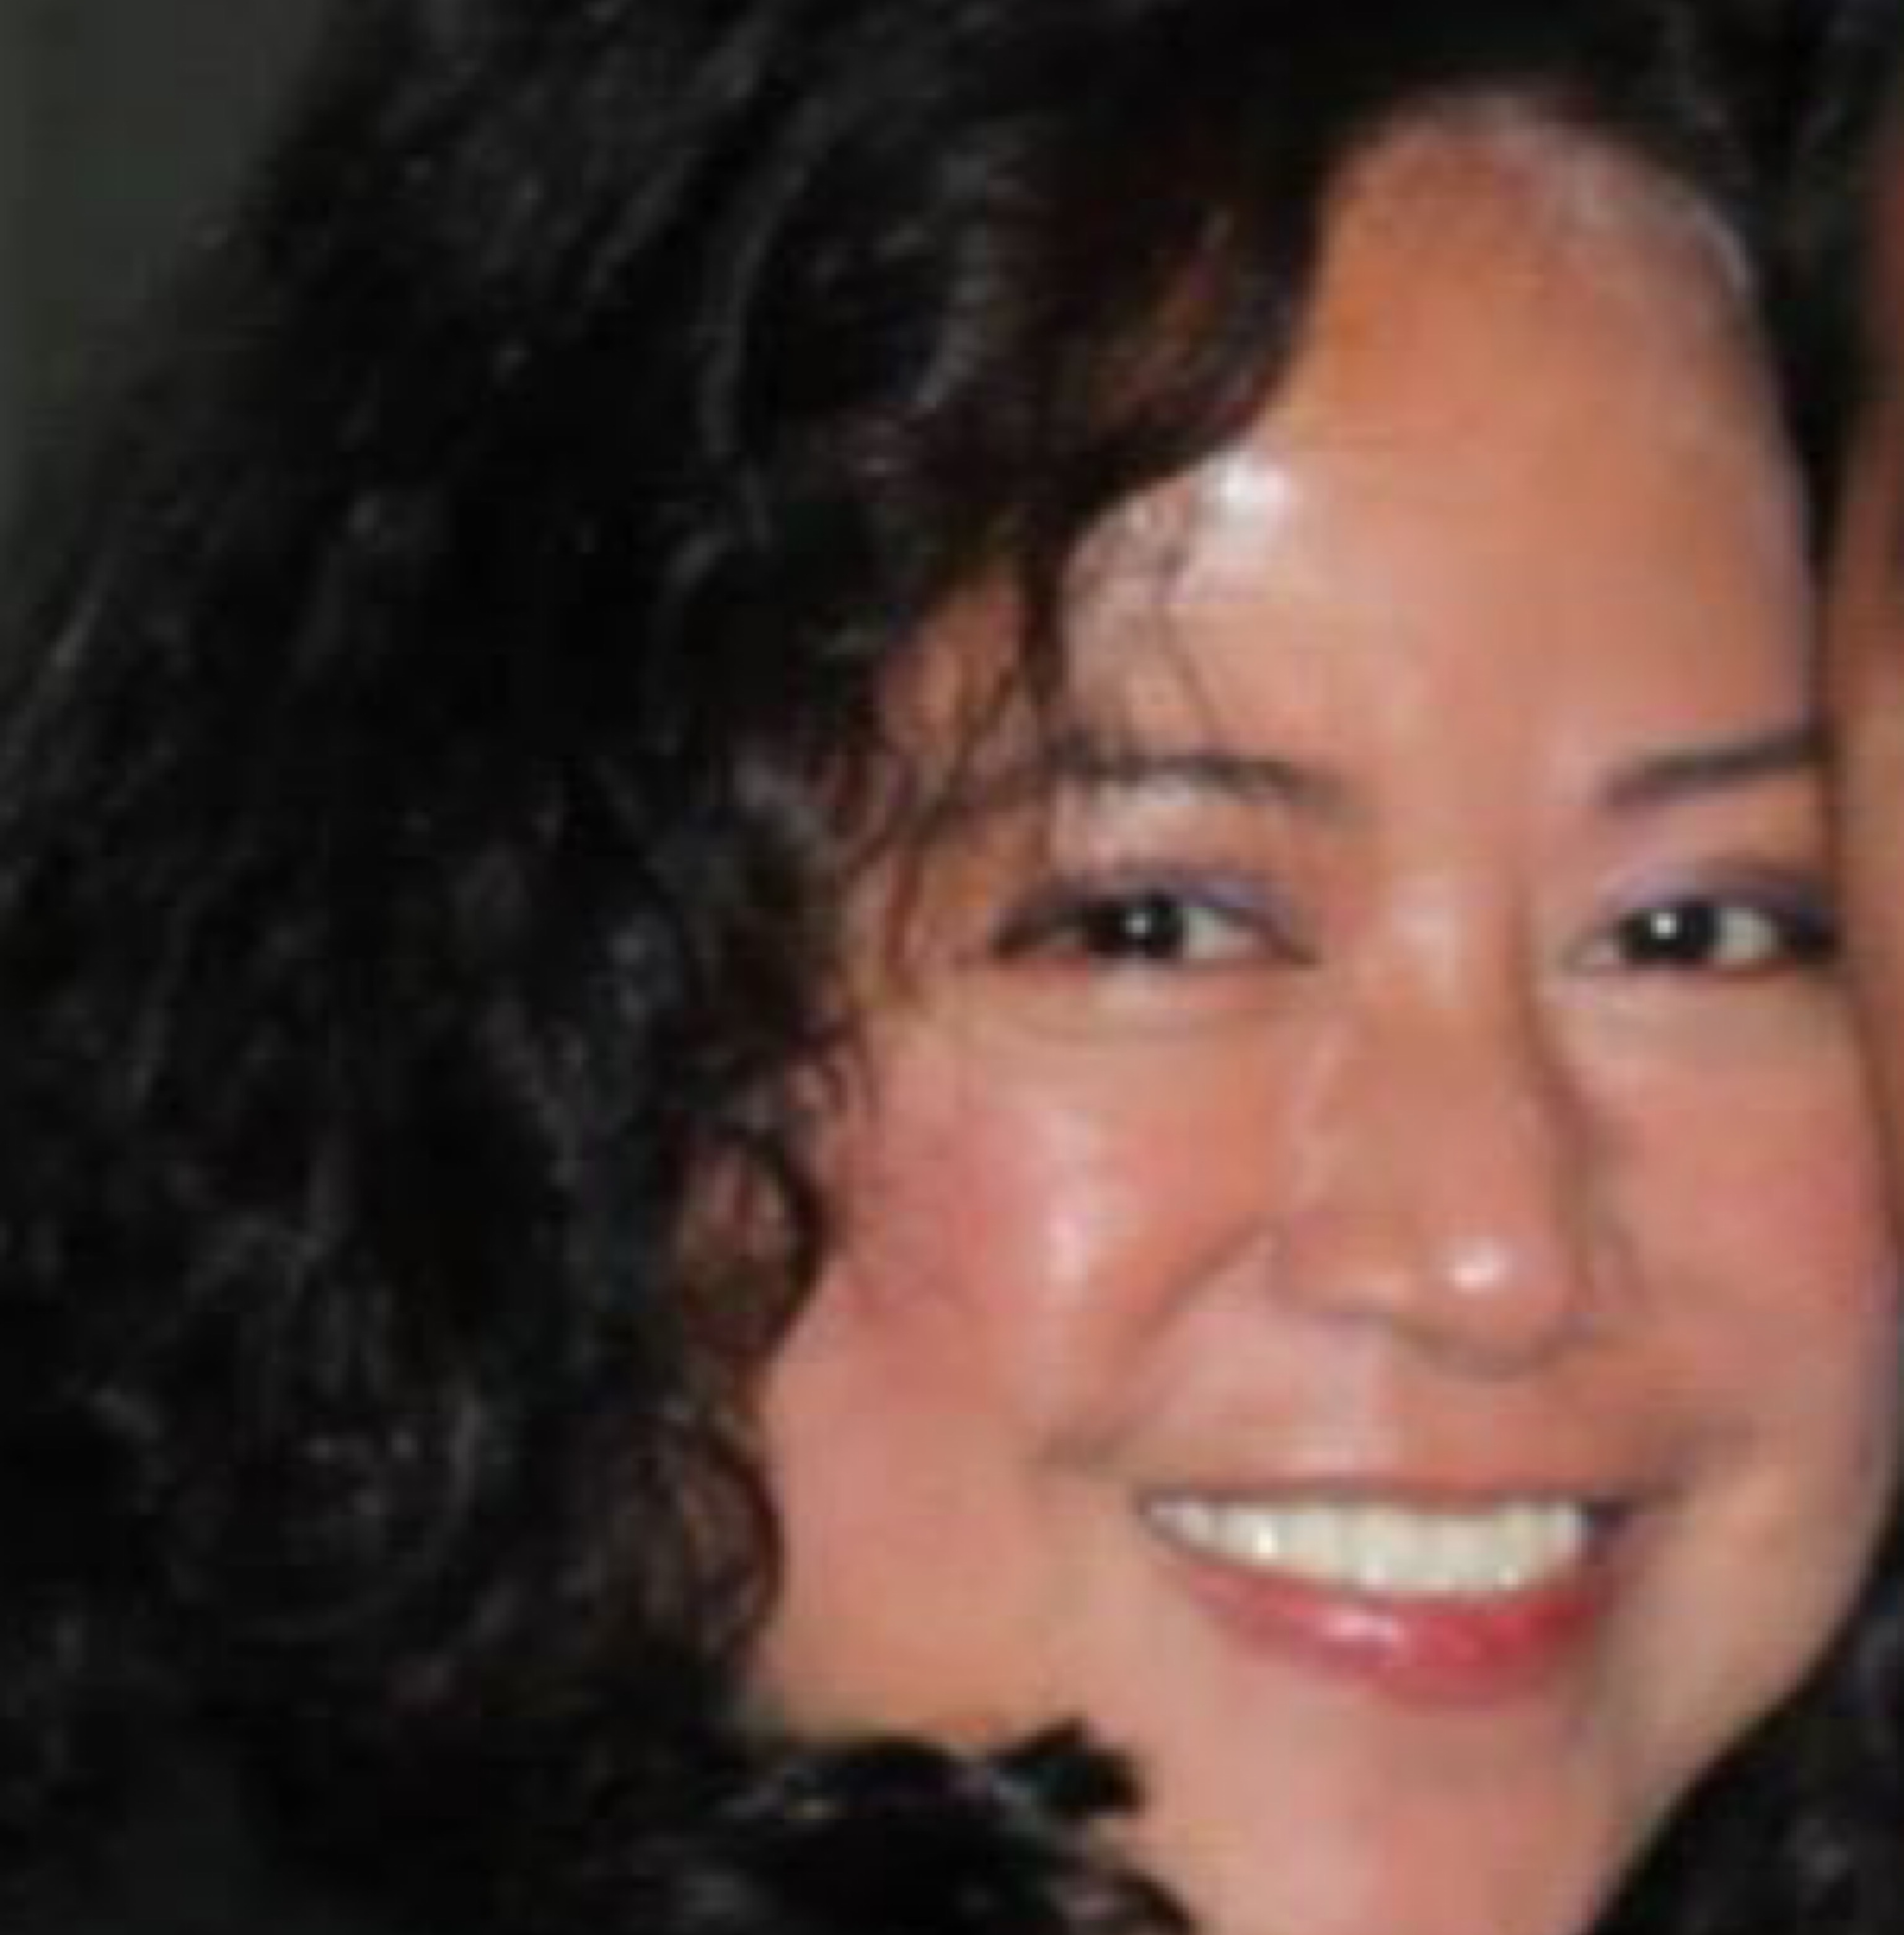

TEAM
Ana Davalos
Diana Chacon
Paula Urteaga
Frances Gliane
Evgeniya Grigoreva

Slide 3
Day 1
Topic - California Power Generation & Power sources
Data Set: https://gis.data.ca.gov/datasets/CAEnergy::california-power-plants?geometry=-147.509%2C31.065%2C-82.163%2C43.271
Inspiration
Ideal Visuals
Proposal

Slide 4
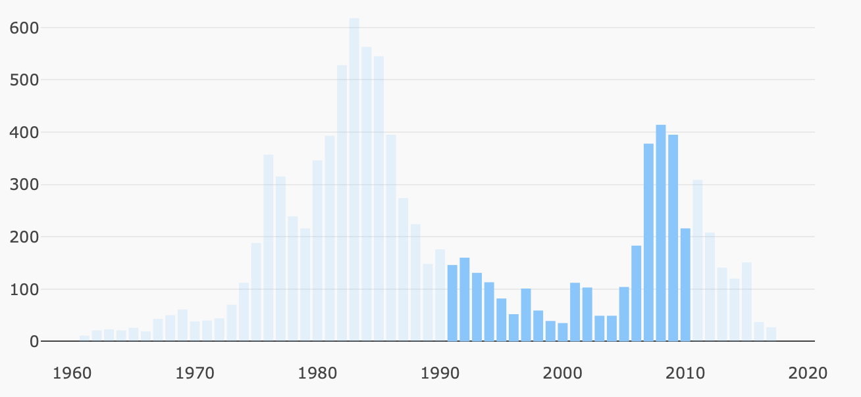
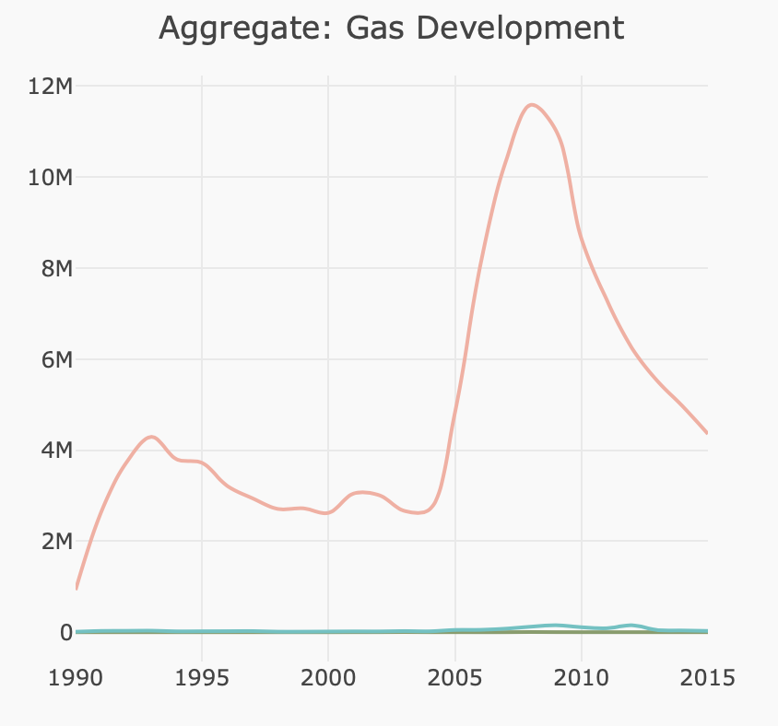
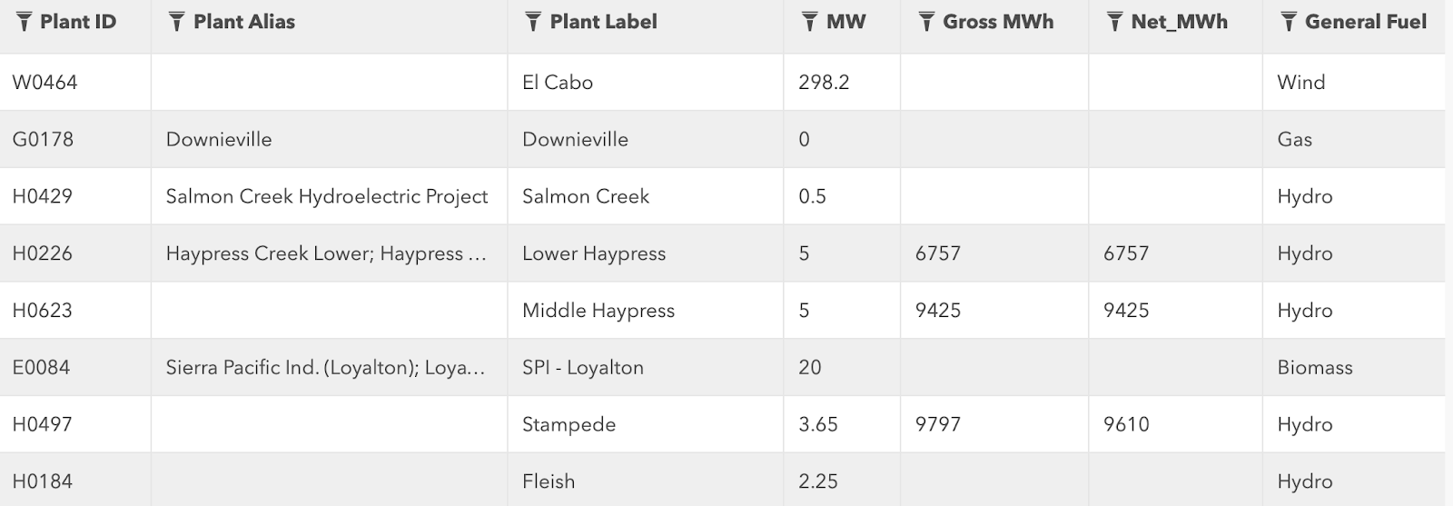
Day 1. inspiration

Slide 5
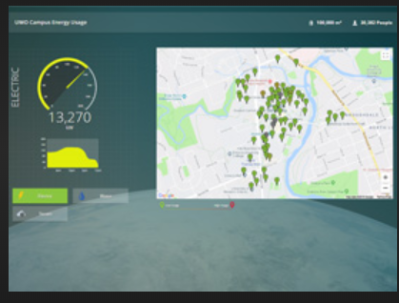
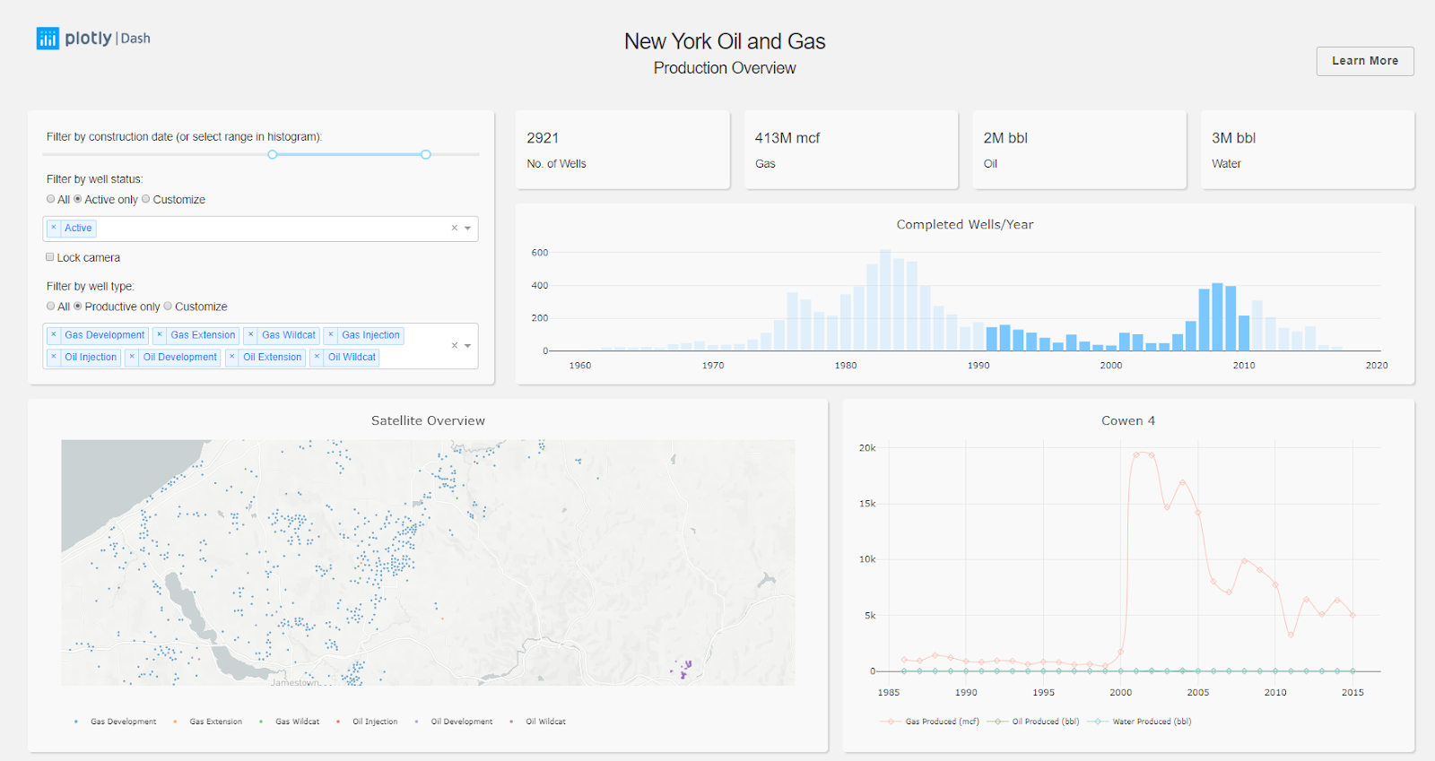
Day 1. inspiration

Slide 6
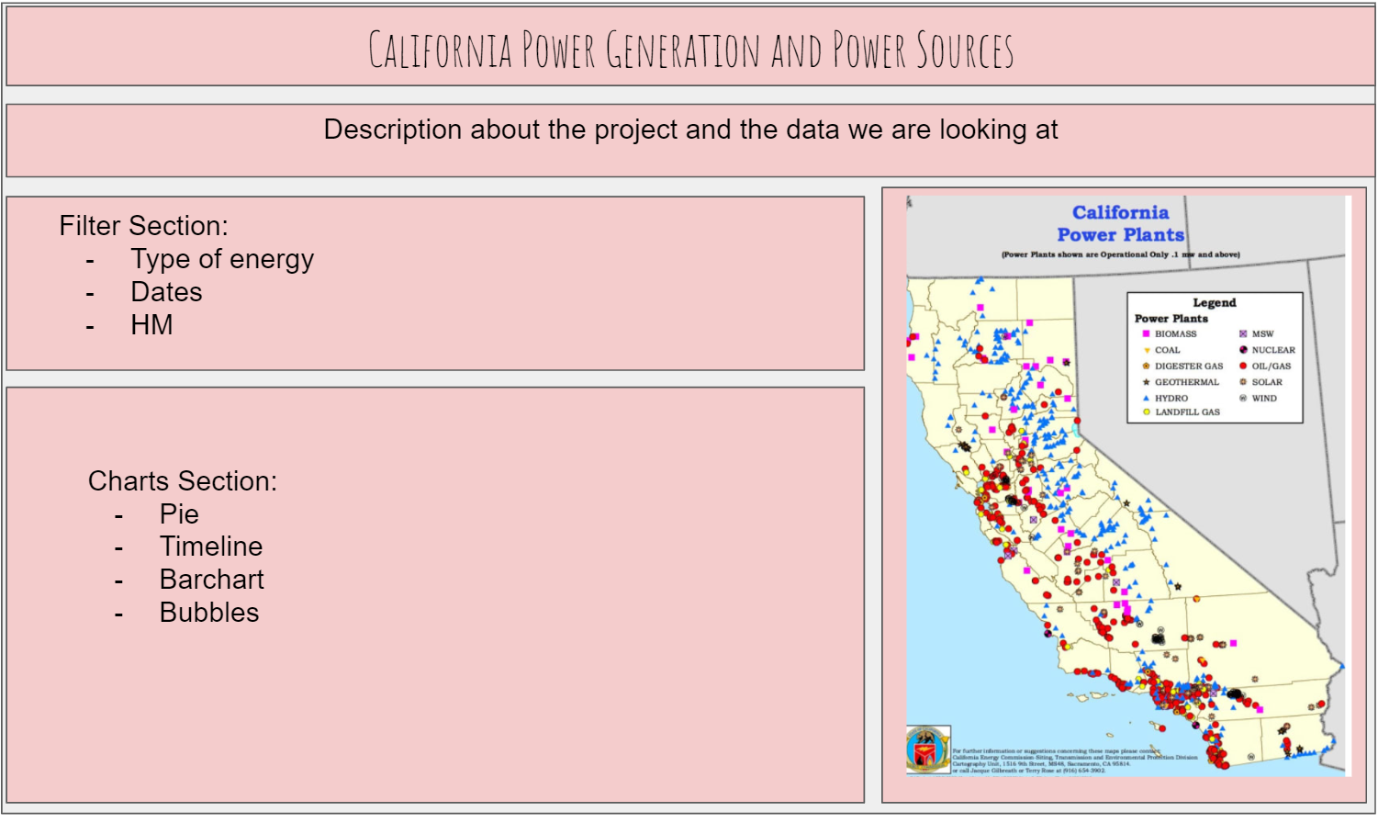
Day 1. UI PROTOTYPE

Slide 7
Day 2
Brief articulation
Metadata
Sketch of the final design
Link to the Primary GitHub: https://github.com/dcchacon/WhoRunTheWorld_Energy
Link to the FINAL GitHub: https://github.com/dcchacon/Project3_Final

Slide 8
DAY 2. BRIEF ARTICULATION
California has large energy resources, being among the top producers of oil, hydroelectricity, solar, biomass, and geothermal energy in the US. Our dashboard displays installations, PRODUCTIONS, and distribution

Slide 9
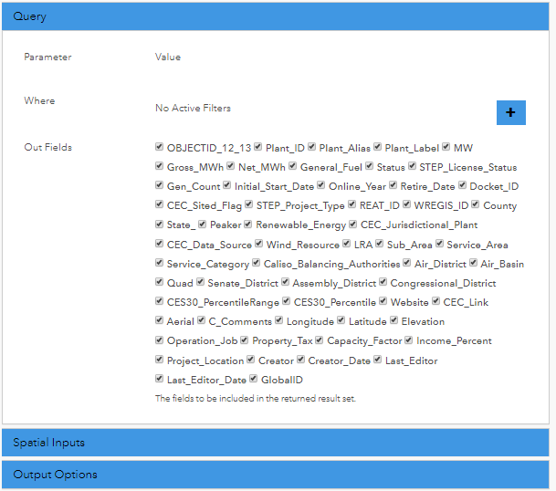
FGDC METADATA:
https://services3.arcgis.com/bWPjFyq029ChCGur/arcgis/rest/services/Power_Plant/FeatureServer/0/metadata?format=default&f=html
Day 2. METADATA

Slide 10
Day 3
PROJECT ROAD MAP DESIGN
Scrape the data when our dataset was updated
Flask -> GeoJSON (as a file) -> S3
GeoJSON file / READ / ROUTE

Slide 11



JavaScript
Call API
Flask: Use MongoDB,
to create an API
HTML
DATA

Slide 12
DAY 4-5-6
Project DESIGN
Javascript coding
PYTHON + FLASK CODING
HTML DESIGN

Slide 13


PROJECT DESIGN
LEAFLET. Energy Types
PLOTLY. Bar chart
HIGH CHARTS. Pie Chart
PLOTLY.
Timeline + Bubble chart
PYTHON + FLASK. HTML table

Slide 14
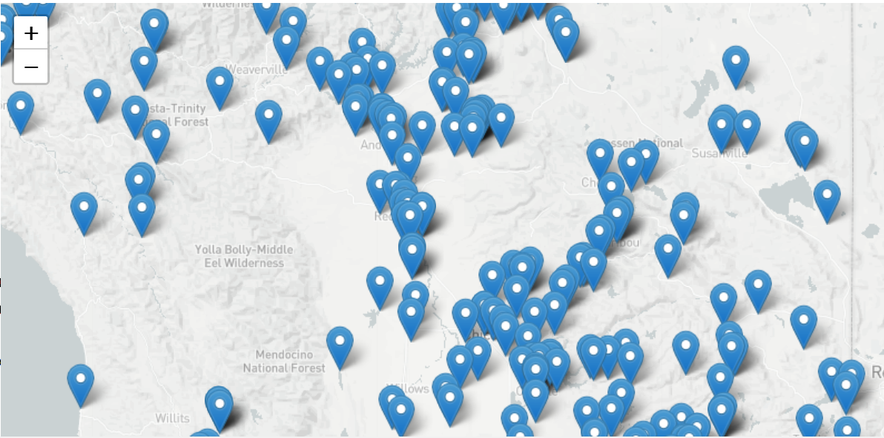
LEAFLET. Energy Types

Slide 15
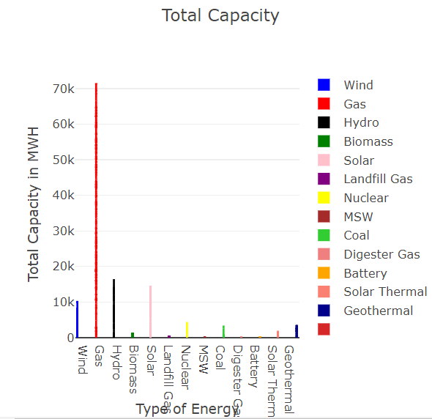
PLOTLY. Bar chart

Slide 16
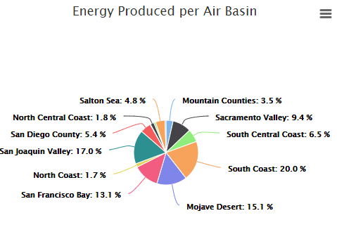
HIGH CHARTS. Pie Chart

Slide 17
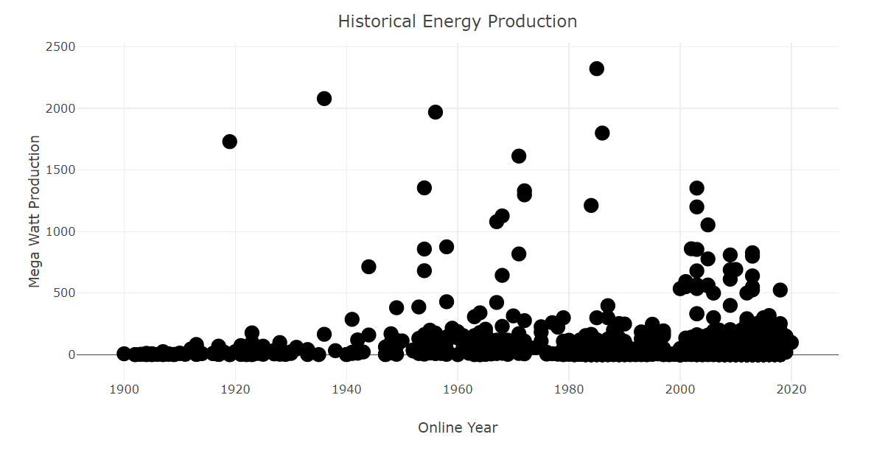
PLOTLY. TIMELINE + BUBBLE Chart

Slide 18
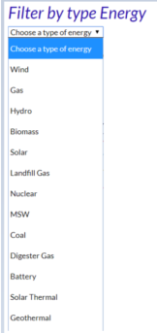
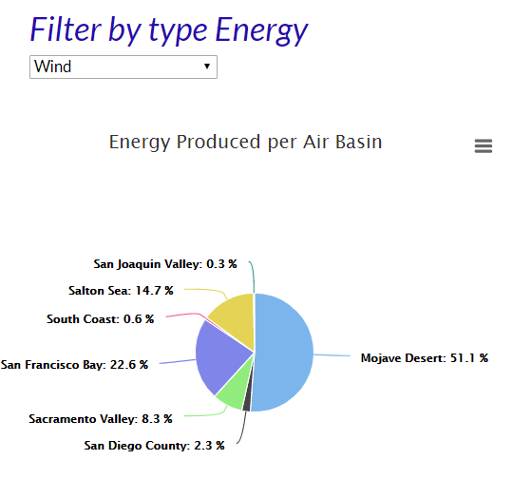
HIGH CHARTS. Pie Chart (FILTERED)

Slide 19
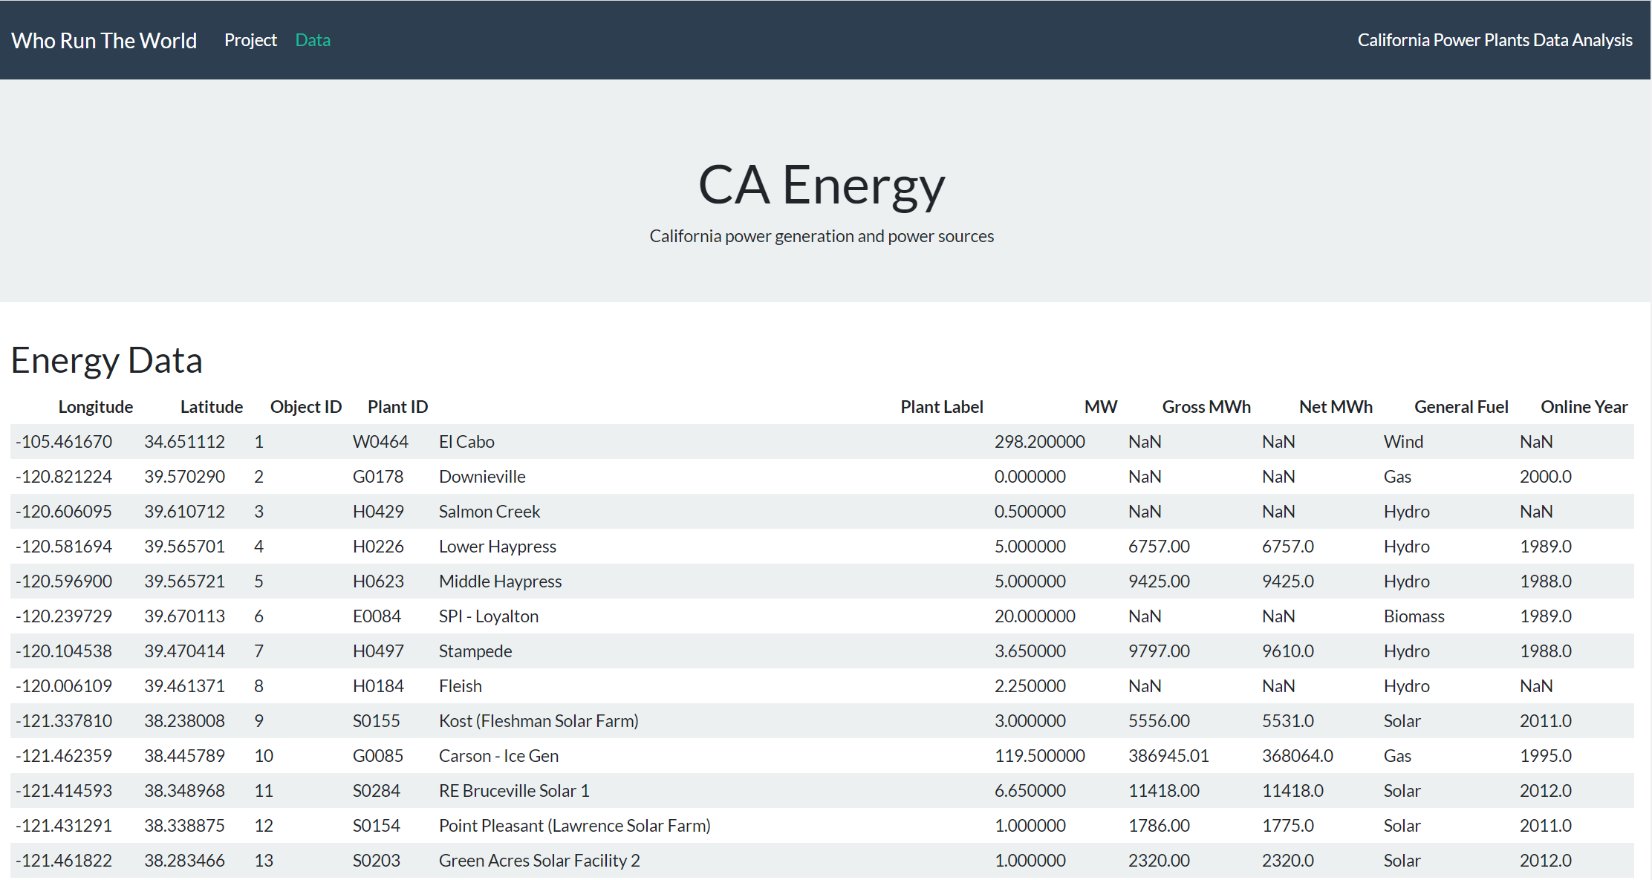
PYTHON + FLASK. HTML table

Slide 20



GITHUB TEAMWORK
GITHUB PROJECT 1
GITHUB PROJECT 2
WHEN WE WORK TOGETHER, EVERYBODY WINS

Slide 21



Process
GeoJSON
HTML PAGE
ENERGY PROJECT
JAVASCRIPT LIBRARIES,
PYTHON
FLASK

Slide 22

Questions?
Check our GITHUB repository for results:
https://github.com/dcchacon/WhoRunTheWorld_Energy
https://github.com/paulaurteaga/Project3_final
GITHUB PROJECT 1
GITHUB PROJECT 2

